Slide 1
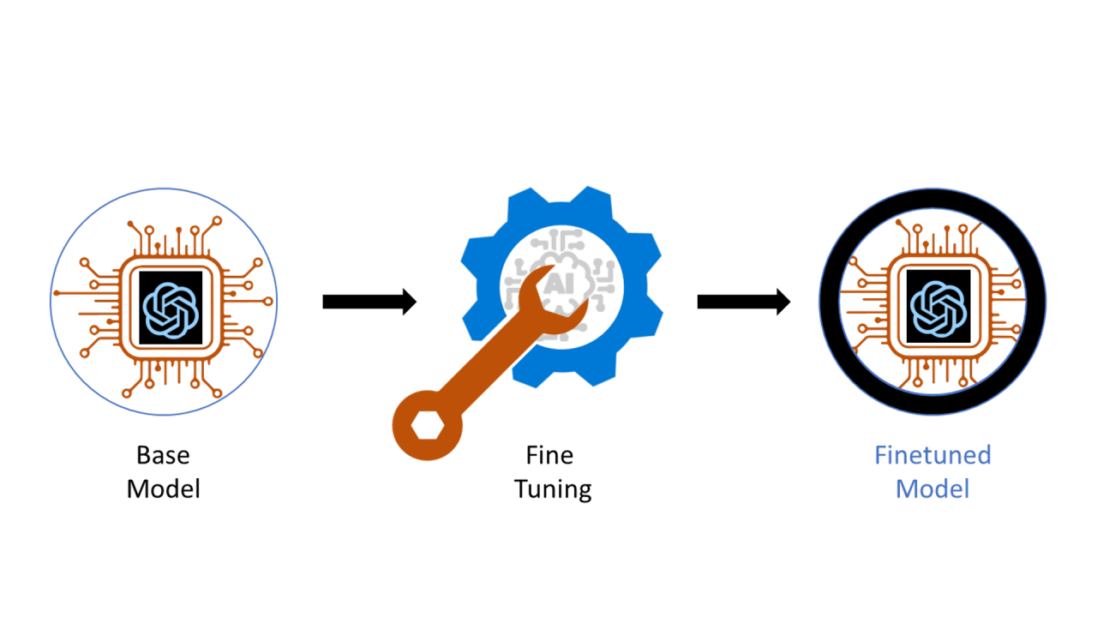
DPO & KTO
1.29.2026

Slide 2
Direct Preference Optimization: Your Language Model is Secretly a Reward Model
The Alignment Problem
Large language models are powerful but not naturally aligned with human preferences
Traditional solution: Reinforcement Learning from Human Feedback (RLHF)
RLHF pipeline is complex, unstable, and computationally expensive
Goal: Align model outputs with human preferences in a simpler, more stable way
1/20

Slide 3
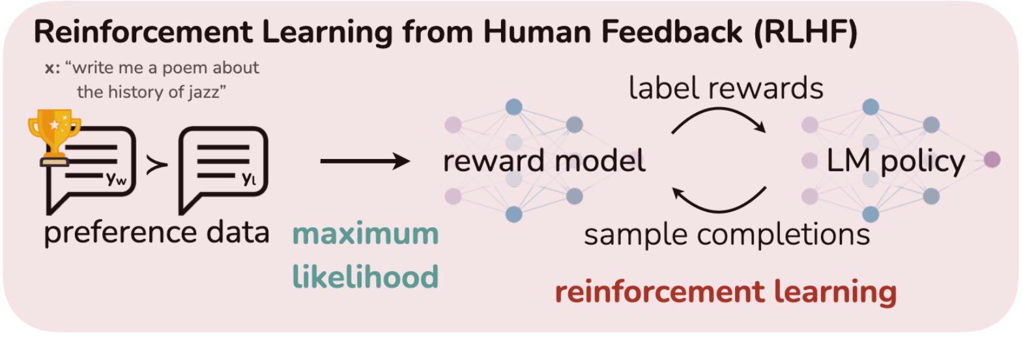
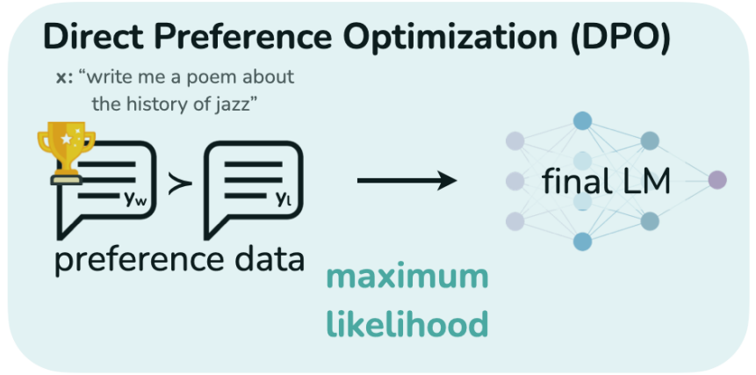
Direct Preference Optimization: Your Language Model is Secretly a Reward Model
How RLHF Traditionally Works
Collect human preference data (A vs B responses)
Train a reward model to score outputs
Use reinforcement learning (PPO) to train the language model to maximize reward
Add KL penalty to keep model close to original
Problems:
Multiple training stages
Sensitive to hyperparameters
RL instability
2/20

Slide 4


How RLHF Works
Direct Preference Optimization: Your Language Model is Secretly a Reward Model
RLHF
When was Einstein born?
Pretrain a base LLM
Let the LL, produce pairs of output
A reward model mimics human ratings
LLM trains to receive high feedback from the reward model
LLM
Reward Model
When was Heisenberg born?
Einstein was born in 1879
3/20

Slide 5
DPO as an Alternative
Direct Preference Optimization: Your Language Model is Secretly a Reward Model
DPO
When was Einstein born?
Pretrain a base LLM
Let the LL, produce pairs of output
LLM trains to assign high probability to positive examples and low probability to negative examples
LLM
When was Heisenberg born?
Einstein was born in 1879
4/20

Slide 6
RLHF vs. DPO
Direct Preference Optimization: Your Language Model is Secretly a Reward Model
RLHF
DPO
Pretrain a base LLM
Let the LL, produce pairs of output
A reward model mimics human ratings
LLM trains to receive high feedback from the reward model
LLM trains to assign high probability to positive examples and low probability to negative examples
5/20

Slide 7
Direct Preference Optimization: Your Language Model is Secretly a Reward Model
Training adjustments
DPO uses pairwise human preference data:
For a prompt x:
y_{w} = preferred (winning) response
y_{l} = rejected (losing) response
Dataset example: (x, y_{w}, y_{l})
We train a new model πθ(y|x) that:
Assigns higher probability to preferred responses
Stays close to the original model π_{ref}(y|x)
This replaces reward maximization + KL constraint in RLHF
6/20

Slide 8
Direct Preference Optimization: Your Language Model is Secretly a Reward Model
The Core DPO Loss Function
For each preference pair (x, y_{w}, y_{l}):
DPO increases the probability of the preferred answer relative to the base model.
It compares how much the new model prefers winner over loser vs how much the old model preferred winner over loser
So, we only adjust behavior where humans disagree with the base model
Where:
σ = sigmoid function
β = temperature (controls strength of preference learning)
7/20

Slide 9
Direct Preference Optimization: Your Language Model is Secretly a Reward Model
Key Observations
Why it works
No reward model needed
No sampling loop
No PPO or policy gradients
Training becomes: Standard gradient descent on a classification-style loss
Much simpler and more stable than RLHF
Benefits
Simpler training pipeline
More stable optimization
Lower compute cost
Competitive or better performance vs RLHF
Big Takeaway
DPO reframes alignment as:
"Make preferred answers more likely than rejected ones — relative to the original model."
A clean, direct alternative to reward modeling and reinforcement learning.
8/20

Slide 10
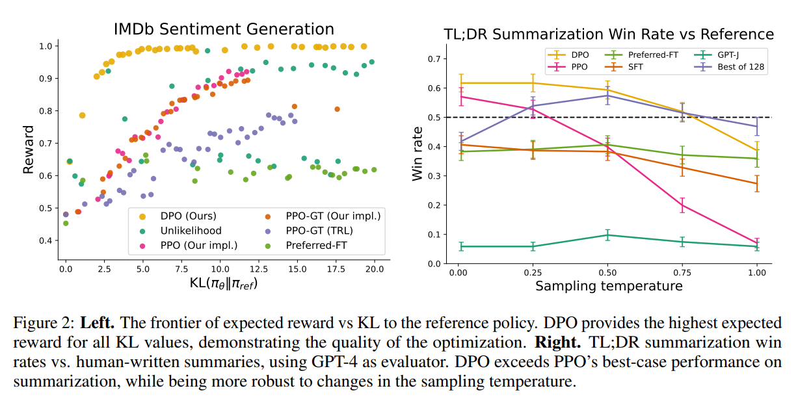
Direct Preference Optimization: Your Language Model is Secretly a Reward Model
Performance
9/20

Slide 11
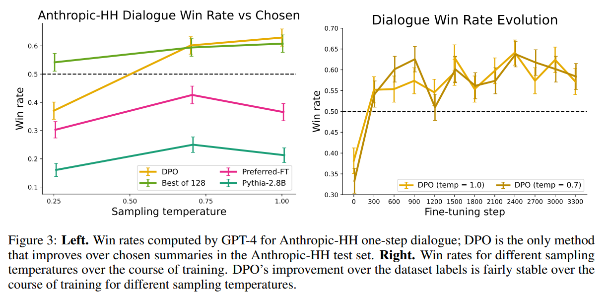
Direct Preference Optimization: Your Language Model is Secretly a Reward Model
Performance
10/20

Slide 12
KTO: Model Alignment as Prospect Theoretic Optimization
KTO: Prospect Theoretic Optimization for Model Alignment
A novel approach to aligning large language models with human preferences based on prospect theory — a cognitive model of human decision-making that explains how humans perceive risk, value, and utility in a biased but consistent way.
Traditional alignment methods like RLHF and DPO succeed partly because they incorporate human decision biases, but they implicitly define human utility in ways that differ from how humans actually evaluate outcomes. The KTO paper builds on this insight.
11/20

Slide 13
KTO: Model Alignment as Prospect Theoretic Optimization
Prospect Theory
Prospect theory explains why, when faced with an uncertain event, humans make decisions that do not maximize their expected value.
Gamble: $100 with 80% and $0 with 20%.
A person might prefer $60 for 100% even though the expected return if they gambled was $80 as they might be loss-averse.
12/20

Slide 14
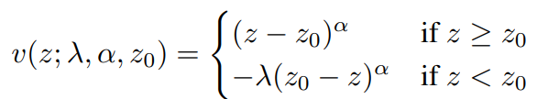
KTO: Model Alignment as Prospect Theoretic Optimization
Prospect Theory (Tversky and Kahneman, 1992)
A value function maps an outcome 𝑧, relative to reference point 𝑧0, to its perceived (subjective) value.
Tversky and Kahneman proposed the following functional form for human value:
𝛼 controls the curvature of the function (risk aversion)
𝜆 controls the steepness of the function (loss aversion)
13/20

Slide 15
KTO: Model Alignment as Prospect Theoretic Optimization
The Model Alignment Challenge
When training language models to be helpful and aligned with human intent, we typically rely on human preferences — for example, ranking one model output over another. But collecting pairwise preferences is costly and doesn’t fully capture how humans value outcomes. Traditional objectives maximize preference likelihood rather than human utility itself.
KTO frames alignment as directly maximizing human utility, which can lead to better alignment, simpler optimization, and reduced annotation effort.
14/20

Slide 16
KTO: Model Alignment as Prospect Theoretic Optimization
Human-Aware Loss Functions(HALOs)
The authors observe that many alignment objectives (like DPO and PPO) inherently behave like a family of loss functions they call Human-Aware Losses (HALOs) — loss functions that reflect certain human biases. The key difference with traditional log-likelihood maximization is that HALOs attribute implicit utility to outcomes.
However, existing HALOs don’t directly model human utility consistent with prospect theory. KTO proposes a new HALO that does that.
15/20

Slide 17
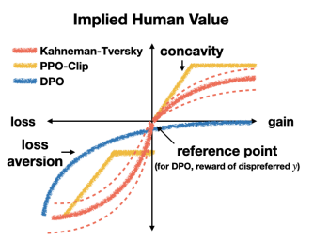
KTO: Model Alignment as Prospect Theoretic Optimization
Reward function comparisons
DPO (Blue Curve)
Flatter near the origin: DPO treats changes close to the reference more linearly.
Less curvature overall: It doesn’t strongly amplify gains or losses.
Implies a mild notion of human value — it pushes for preferred outputs but does not strongly model human loss aversion.
This reflects DPO’s design:
Directly optimize preferences without modeling human decision biases explicitly. → It treats any deviation from the reference according to likelihood differences, not psychological utility.
16/20

Slide 18
KTO: Model Alignment as Prospect Theoretic Optimization
Reward function comparisons
PPO-Clip / RLHF (Yellow Curve)
Has some curvature: moves away from linear.
A bit steeper in the gains region and slightly asymmetrical.
Represents that PPO-based RLHF implicitly encodes some preference for gains (preferred outputs) and discourages losses (undesirable outputs), due to the reward model + KL penalty.
But RLHF’s implicit human value shape is not grounded in cognitive models — it’s shaped by the learned reward model and the KL constraint.
17/20

Slide 19
KTO: Model Alignment as Prospect Theoretic Optimization
Reward function comparisons
Kahneman-Tversky / KTO (Red Curve)
This is the important one for the paper:
S-shaped curve: concave in the gains region, convex in the losses region
Steeper for losses than gains → loss aversion
Exhibits classic prospect theory features — a small gain gives some utility, but a small loss hurts more.
This means KTO explicitly models how humans subjectively value outcomes:
✔ People dislike losses more than they enjoy equivalent gains ✔ Progress becomes less valuable as you get farther into large gains (concavity) ✔ Small deviations are more psychologically impactful than linear models suggest
This is exactly the human utility structure Kahneman and Tversky described, and KTO adopts this to optimize model behavior that aligns with human valuation, not just preferences.
18/20

Slide 20
KTO: Model Alignment as Prospect Theoretic Optimization
Reward function comparisons
Why This Matters for Model Alignment
DPO treats preferences in a statistical way (likelihood differences), which works well but lacks a principled human utility interpretation.
RLHF / PPO implicitly shapes utility via reward models, but its biases might not align with human behavioral economics.
KTO explicitly shapes optimization with a theoretically grounded human value function (prospect theory), making alignment closer to how humans actually judge outcomes.
Put simply:
KTO optimizes for how humans evaluate gains and losses, not just which outcome humans prefer.
This graph visually contrasts implicit human value assumptions in each method.
19/20

Slide 21
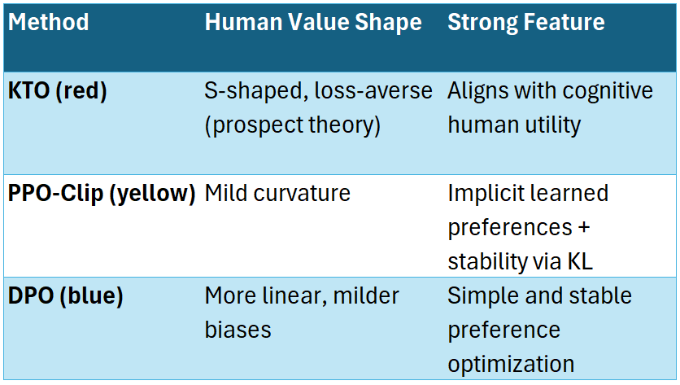
KTO: Model Alignment as Prospect Theoretic Optimization
Reward function comparisons
20/20

Slide 22
END
1.29.2026

